Slide 1

Flocculator Design

Slide 2
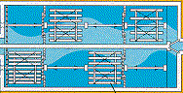

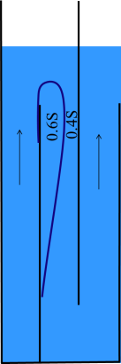

Overview
Mechanical Design
Analysis of hydraulic flocculators
Vena contracta
Head loss per bend
Design for energy efficiency
Flocculator Design (top-down, bottom-up)
Head loss, collision potential, residence time
Geometry of a baffle space to obtain desired energy dissipation rate
Flocculator Geometry
Reflections

Slide 3
Ten State Standards
The detention time for floc formation should be at least 30 minutes with consideration to using tapered (i.e., diminishing velocity gradient) flocculation. The flow‑through velocity should be not less than 0.5 nor greater than 1.5 feet per minute.
Agitators shall be driven by variable speed drives with the peripheral speed of paddles ranging from 0.5 to 3.0 feet per second. External, non-submerged motors are preferred.
Flocculation and sedimentation basins shall be as close together as possible. The velocity of flocculated water through pipes or conduits to settling basins shall be not less than 0.5 nor greater than 1.5 feet per second. Allowances must be made to minimize turbulence at bends and changes in direction.
Baffling may be used to provide for flocculation in small plants only after consultation with the reviewing authority. The design should be such that the velocities and flows noted above will be maintained.
Hydraulic flocculators allowed only by special permission!

Slide 4
AguaClara flocculator design continues to evolve rapidly
2005 - We used conventional guidelines based on velocity gradient to design the first low flow vertical flocculator
2010 - We designed using energy dissipation rate and accounted for the nonuniformity of the energy dissipation rate (θ = 15 minutes)
2015 – We added obstacles to decrease the distance between expansions to make all of our flocculators have maximum collision efficiency (θ = 8 minutes)
2016 – Learned that particle/floc collisions are dominated by viscous shear (not by turbulent eddies)
2019 – Learned that head loss is higher than we had predicted
202x –We increase the efficiency of removal of small particles by inventing???????

Slide 5

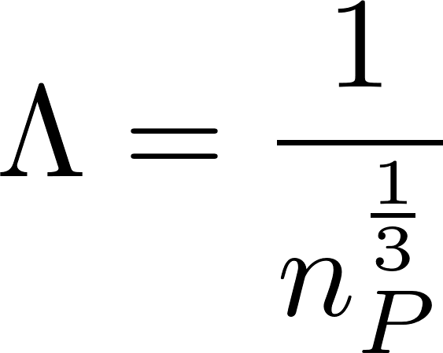
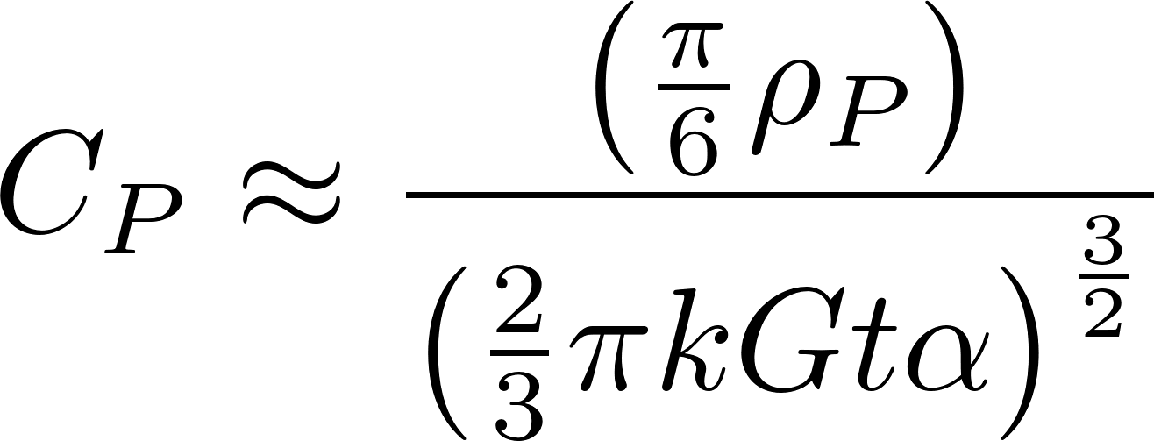
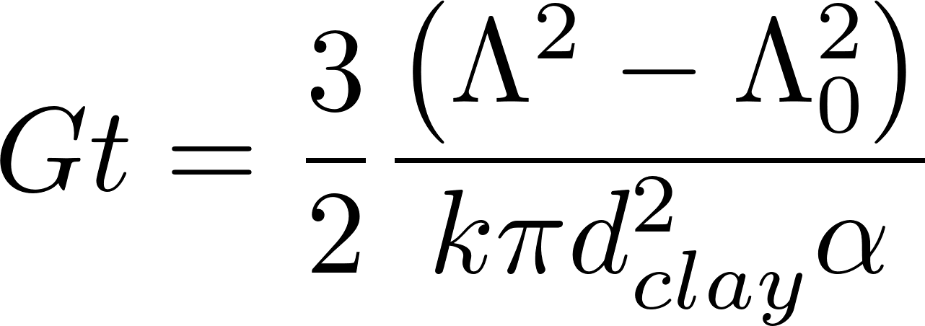
AguaClara Hydraulic Flocculation Model
Final distance between primary particles
Flocculation time
Initial distance between primary particles
Velocity Gradient
Probability that collision point is sticky
Diameter of primary particles
A Hydrodynamic and surface coverage model capable of predicting settled effluent turbidity subsequent to hydraulic flocculation WH Pennock, ML Weber-Shirk, LW Lion Environmental Engineering Science 35 (12), 1273-1285 (2018)

Slide 6
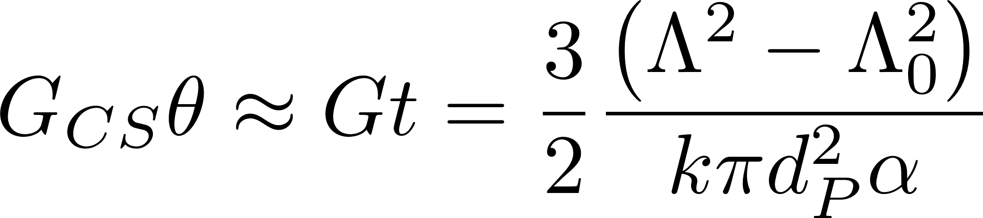
Collision Potential
The target collision potential used for the design of AguaClara plants since about 2013 has been 37,000
This equation assumes that the velocity gradient in the flocculator is uniform
Our design approach will ensure that the velocity gradient is as uniform as practically possible

Slide 7

Flocculator Geometry
Entrance
2 Channels
Port between channels
Exit
Lower Baffles
Upper Baffles
Notes:
planta de 50 Lps con 2 cámaras de sedimentación

Slide 8

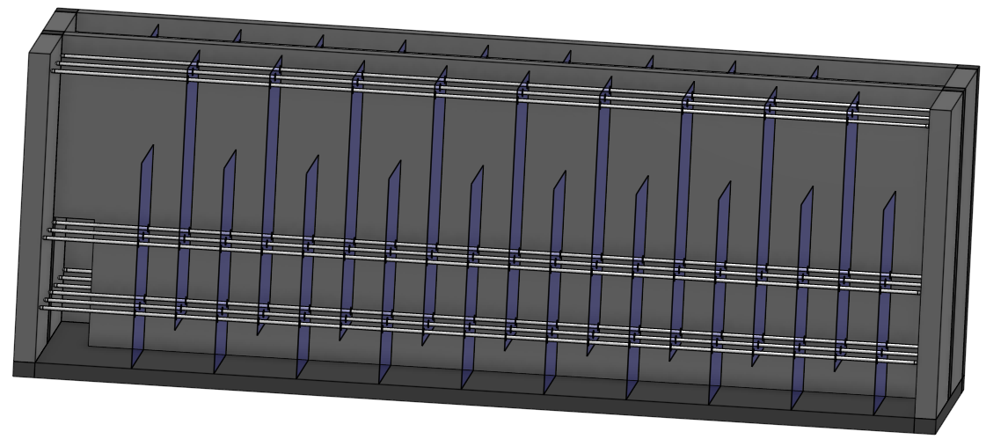
High Rate, Uniform Velocity Gradient, Plug flow, Hydraulic Flocculation
Contractions → Expansions →Turbulence → Viscous deformation of the fluid→ Collisions

Slide 9
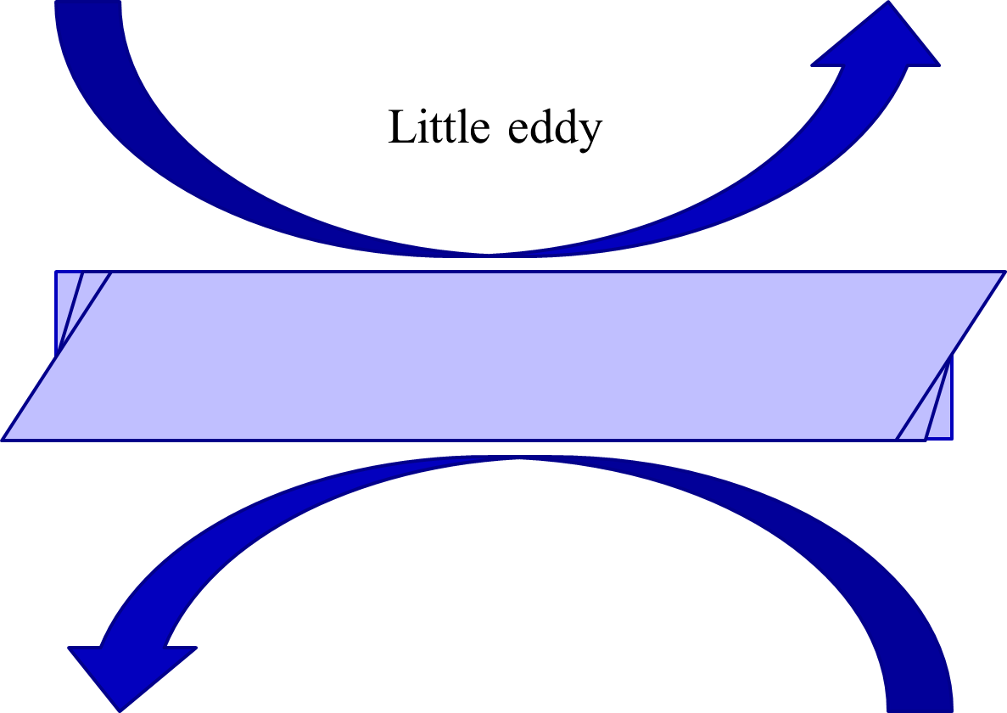
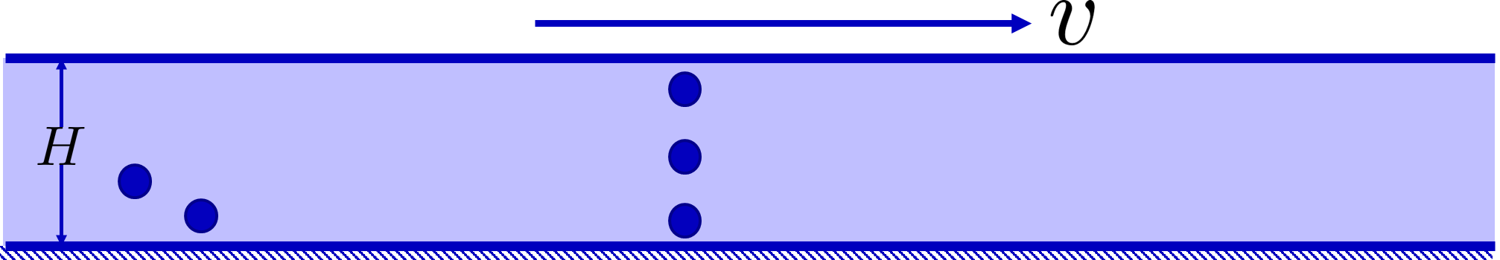
Fluid deformation powered by turbulent kinetic energy and damped by viscosity
Flow expansions convert potential energy into turbulent kinetic energy
Viscosity damps the eddies
Fluid deforms
Particles collide

Slide 10
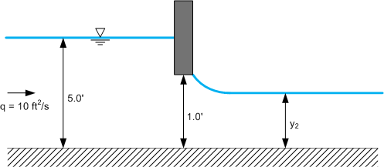
Vena Contracta around a bend?
Sluice gate (almost closed)*
0.59
Small hole in a tank
0.62
Exit from a pipe
No Vena Contracta
By Lindsay Lally, Lee Hixon (Own work) [CC BY-SA 3.0 (http://creativecommons.org/licenses/by-sa/3.0) or GFDL (http://www.gnu.org/copyleft/fdl.html)], via Wikimedia Commons
* Roberson, JA; Cassidy, JJ; Chaudhry, MH. Hydraulic Engineering. John Wiley. (1995) page 217. Original reference is Henry, H.R. “Diffusion of Submerged Jets.” Discussion by M.L. Alberston, Y.B. Dai, R.A. Jensen, and Hunger Rouse, Trans. ASCE, 115, (1950)

Slide 11
Vena Contracta (Π_{VC} ) Conclusions
Draw the most extreme streamline through the transition and determine the total change in direction
If the change in direction for most of the fluid is 90°, then the Π_{VC} is approximately 0.62
If the change in direction for most of the fluid is 180°, then the Π_{VC} is approximately 0.62²=0.384
Notes:
Validation Studies of Fluent Turbulence Models for Fluent Simulations of AguaClara Flocculators
AguaClara Computational Fluid Dynamics Spring 2010
Travis Stanislaus
https://confluence.cornell.edu/display/AGUACLARA/Validation+Studies+for+ANSYS+Fluent+Turbulence+Model+Simulations

Slide 12
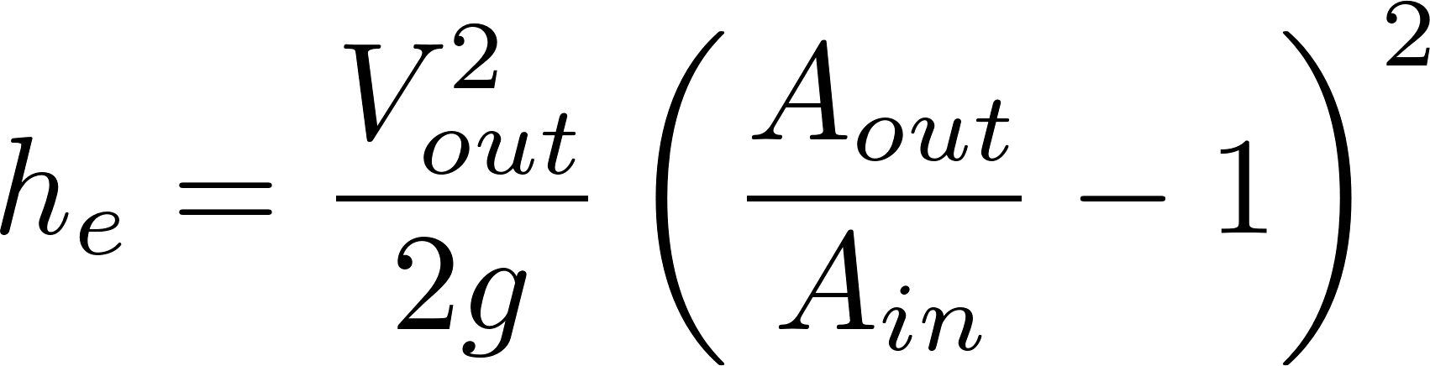
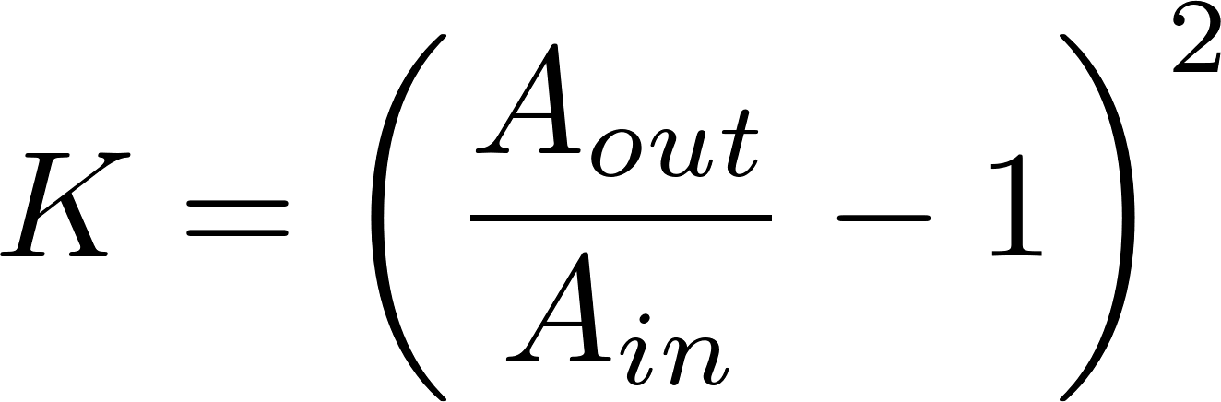
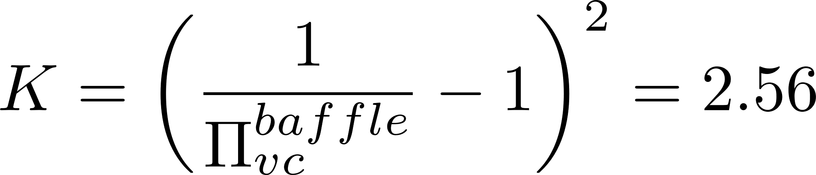
Head Loss coefficient for a single Baffle
Head loss in an expansion
e - expansion
the contraction coefficient for a sharp 180º bend (0.62²)
Notes:
Validation Studies of Fluent Turbulence Models for Fluent Simulations of AguaClara Flocculators
AguaClara Computational Fluid Dynamics Spring 2010
Travis Stanislaus
https://confluence.cornell.edu/display/AGUACLARA/Validation+Studies+for+ANSYS+Fluent+Turbulence+Model+Simulations

Slide 13
Measurements from Hydraulic Flocculators Show Loss Coefficient > 2.6
Flow doesn’t fully expand before going around the next bend!
The velocity entering the bend is higher than we thought!
Next step is to find how far the jet expands before heading into the next contraction

Slide 14

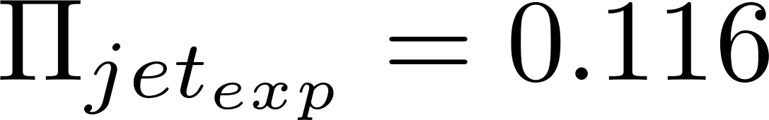
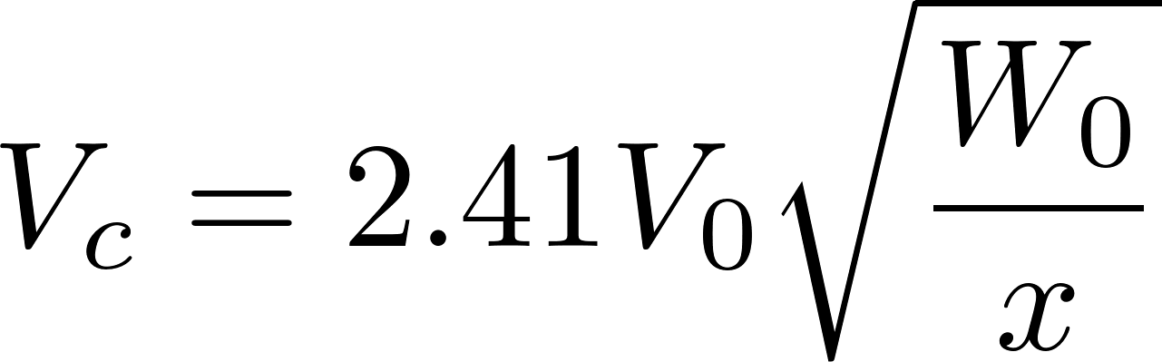

Plane Jets: Empirical Coefficients
We began use this equation for designs in 2020
It is possible that it would be better to use this equation rather than the equation for the width to estimate the minor loss coefficient (because losses scale with velocity squared)
Jet: , V_{o}
Notes:
See Jets & Plumes lecture notes
https://github.com/monroews/Hydraulics/raw/master/Jets_%26_Plumes.pptx

Slide 15
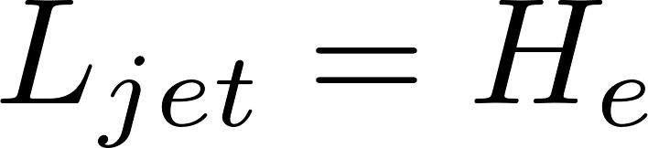
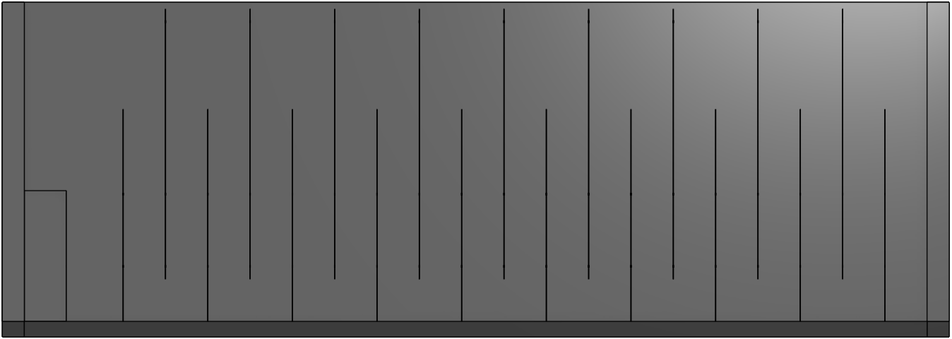

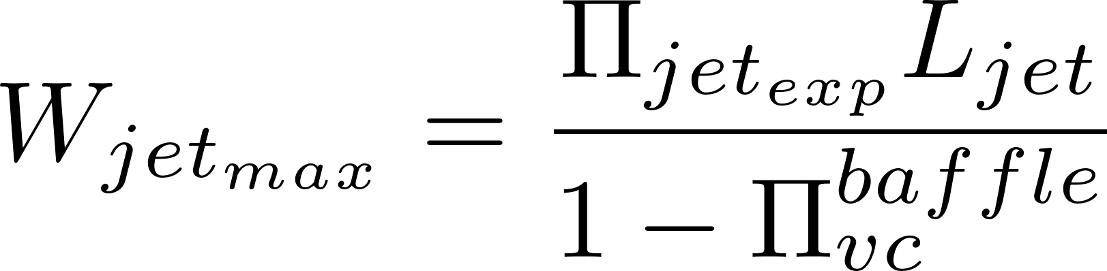
Jet Expansion Geometry for Baffles in Series
Two equations in two unknowns
Flow contraction
S
Flow expansion
H_{e}
L_{jet}
S
Must be <= S
S
The jet doesn’t fully expand if H_{e}/S < 5

Slide 16
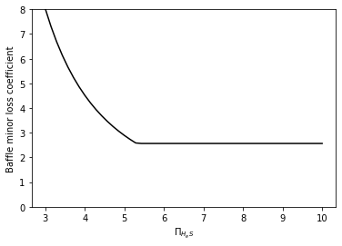
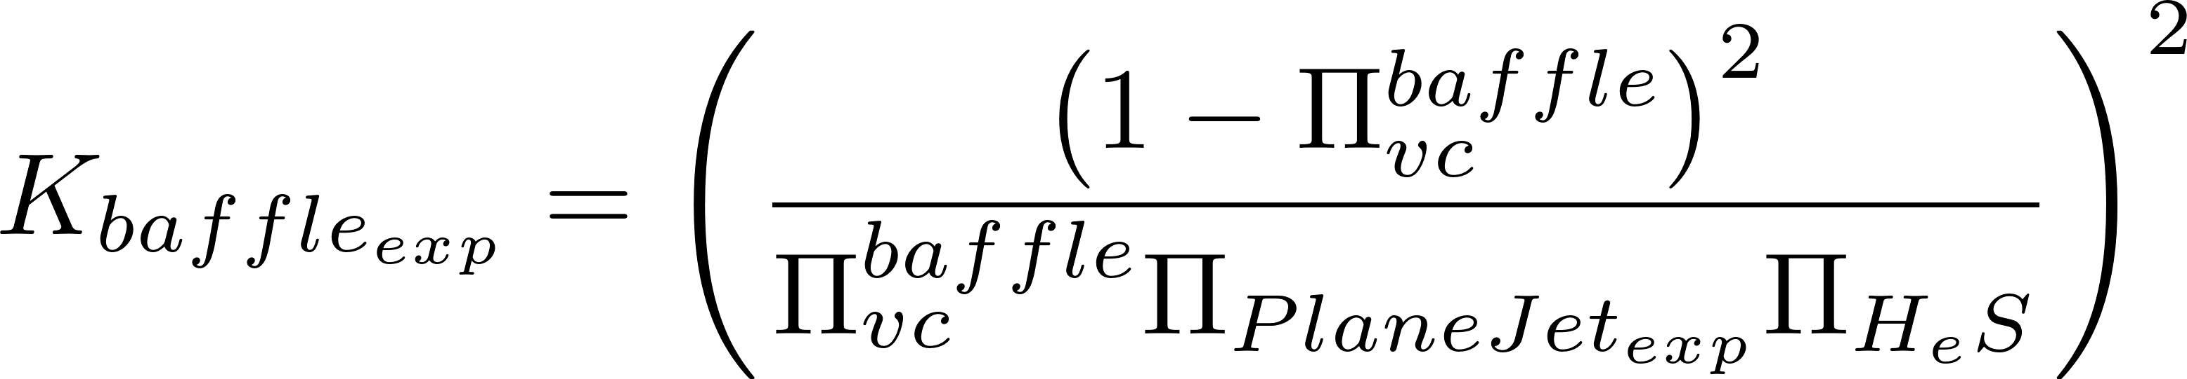
Minor loss for baffles in series*
*These analytical results are a hypothesis and require confirmation either with full scale hydraulic tests or with Computational Fluid Dynamics

Slide 17



Flocculator Efficiency
Which space between baffles is better, considering the uniformity of the energy dissipation rate?
This space with very low energy dissipation rate doesn’t contribute much

Slide 18



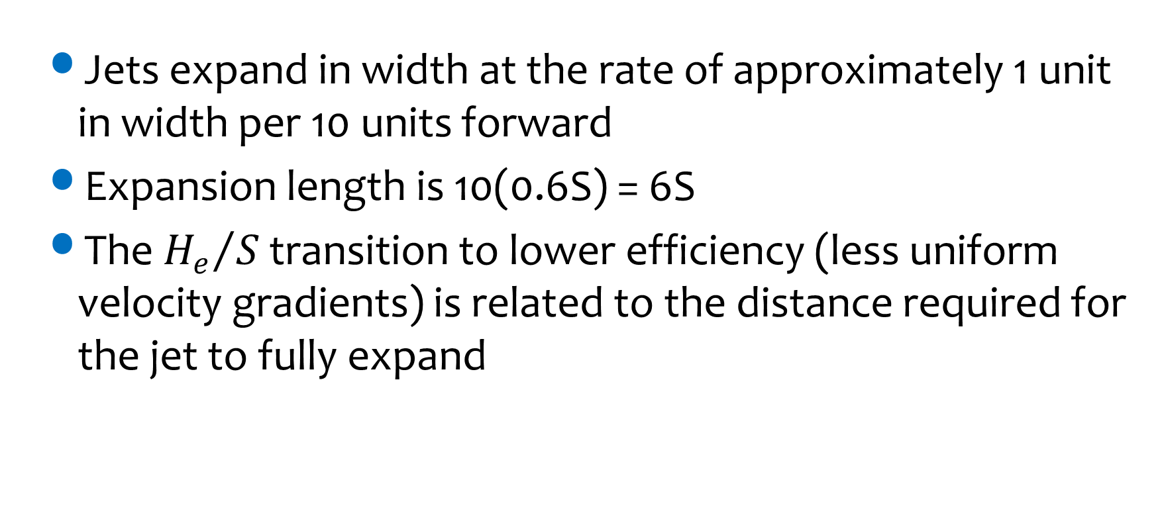

L$ess efficient for{H_{e}}/S$>6
Jets expand in width at the rate of approximately 1 unit in width per 10 units forward
Expansion length is 10(0.6S) = 6S
The ${H_{e}}/S$ transition to lower efficiency (less uniform velocity gradients) is related to the distance required for the jet to fully expand
Notes:
Flocculators with H_{e}/S<5
We need to know what the Baffle head loss coefficient is for this case. It is possible that the head loss coefficient is larger than the 2 that we predict based on the contraction coefficient because the flow will not have fully expanded before going through the next contraction. Thus the head loss is quite possibly higher for the low H/S ratios than what we are assuming. It is important that we figure this out BEFORE we build a large flow plant with a low H/S ratio. We could either obtain a solution using CFD or by conducting laboratory experiments.
It is very likely that the flow fully expands as it goes around the 180 degree bend. Inertia will cause the higher velocity water to move toward the outside of the bend which is where the flow has separated from the baffle. Thus it is quite possible that the head loss is the same for H/S<5 as it is for H/S>5.

Slide 19
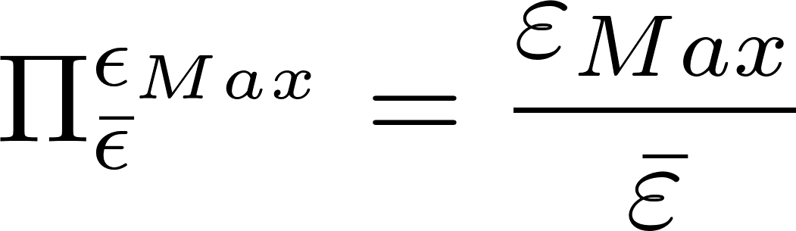
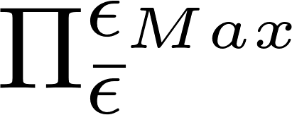
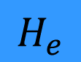
Simplify flocculator design by designing for high efficiency
Efficiency will be a function of the variability of the energy dissipation rate
We expect a relation of the form such that efficiency is 1 when =1 and efficiency is less than 1 for higher values of
We “solve” this unknown by always designing efficient flocculators with 3<H_{e}/S<6 (or perhaps <8 assuming that efficiency doesn’t drop off rapidly)
S
$$H_{e}$$
S
S

Slide 20
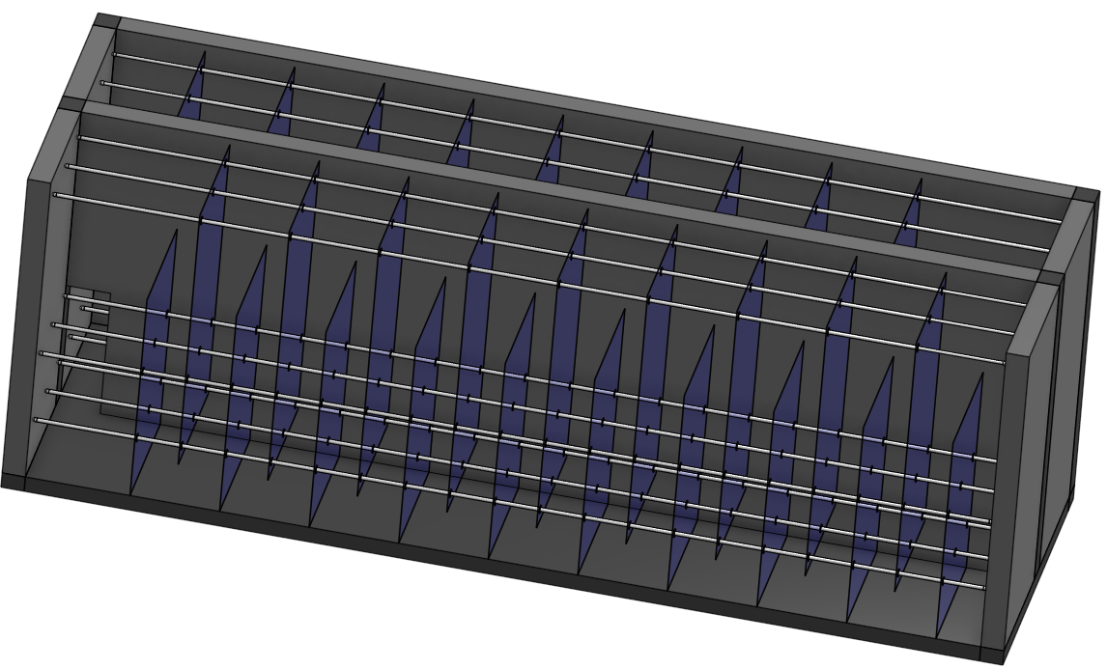
Unknowns
Head loss (change in water elevation from inlet to outlet)
Residence time (t)
Baffle spacing (S)
Number of baffles (N)
Channel length (L)
Channel width (W)
Water depth (HW)
Number of channels
Number of flow expansions per baffle
Total deformation of the fluid (Gt)
Every dimension matters, but how?
Notes:
We want to create a straight path to our solution.

Slide 21
Design Considerations
The length of the flocculator channels matches the length of the sedimentation tank (thus far…)
Width of the flocculation channel?
Minimum? ________________
Material limitations (polycarbonate width)
Optimize to get the desired flocculator volume given the specified length of the channels
Even or odd number of baffles depending on channel inlet and outlet conditions
Human width
Notes:
planta de 50 Lps con 2 cámaras de sedimentación

Slide 22
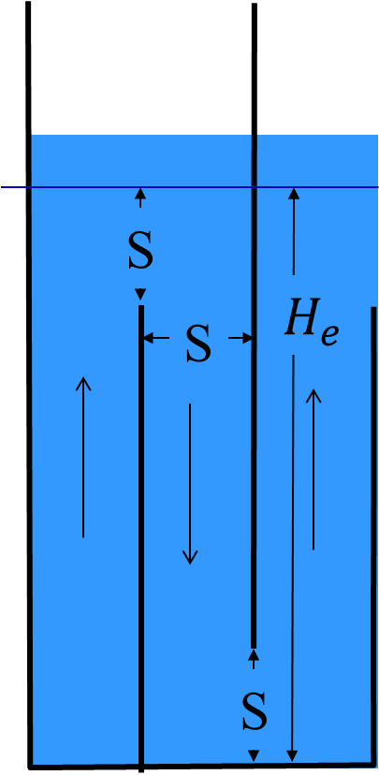
Two design approaches
Bottom up: Start by designing one baffle space (the small details) and then work up to designing the overall size of the flocculator
Only basis for selection of channel width would be W=S
Top down: Start by finding total volume of flocculator required and then go to the details
Enables applying constraints to overall dimensions

Slide 23
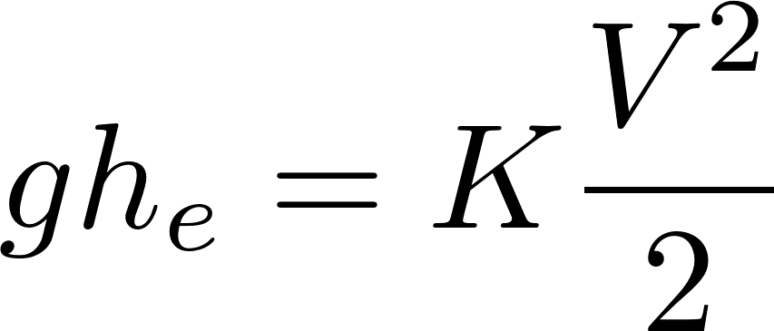
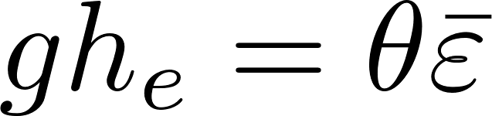
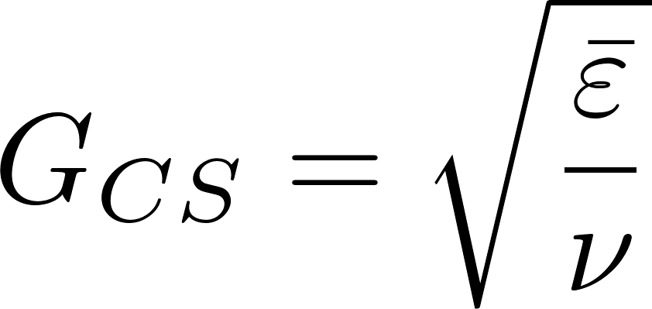
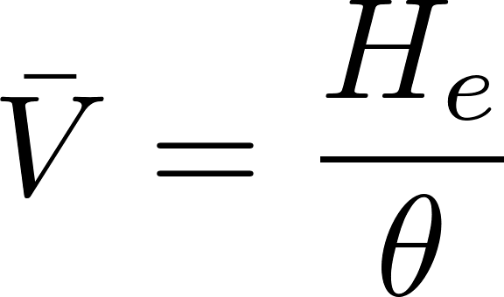
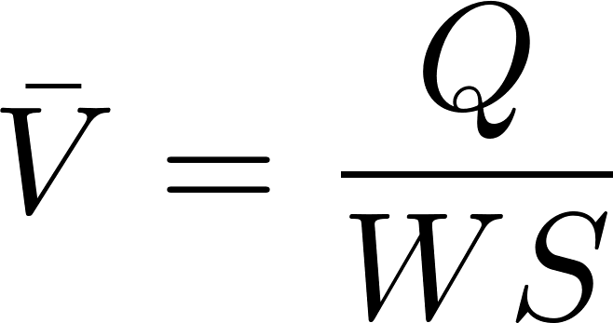
Key equations that we can use to design flocculators
Minor loss equation
Energy dissipation rate must match the rate that mechanical energy is lost*
Fluid deformation is set by the energy dissipation rate and viscosity (CS = Camp Stein) Requires that energy dissipation rate be uniform
Continuity, mass conservation
*On average, potential energy lost in a flow expansion must be dissipated in the residence time of that flow expansion

Slide 24
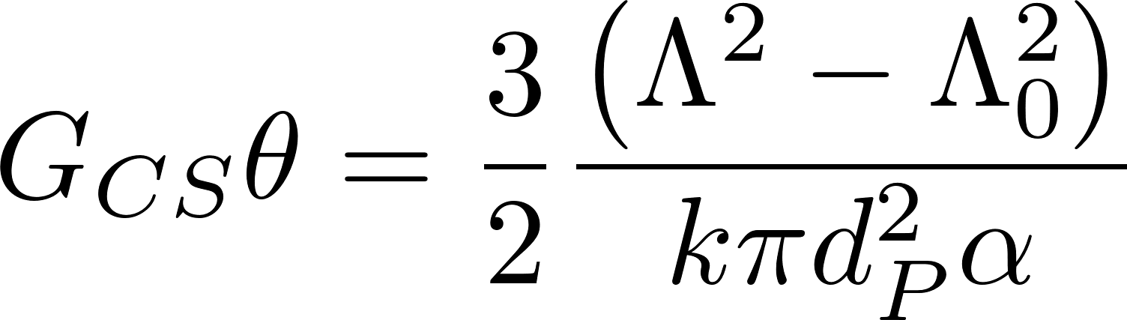
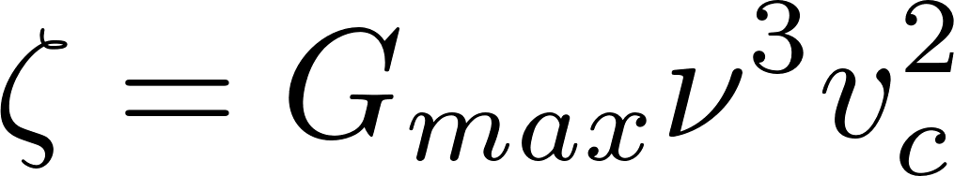
The design inputs for flocculation
We need collisions and thus G_{CS}θ is a logical design specification
We need to specify the maximum velocity gradient that will produce flocs large enough to be captured by the sedimentation tank (at the coldest temperature)
Sed and floc have to be designed together!
Higher G_{CS} means smaller flocs and more elevation drop (head loss) through flocculator
Notes:
This is in part because we don’t have a rational basis to choose the G value for flocculation. There is an economic impact of increasing head loss, so we use that constraint for now.

Slide 25
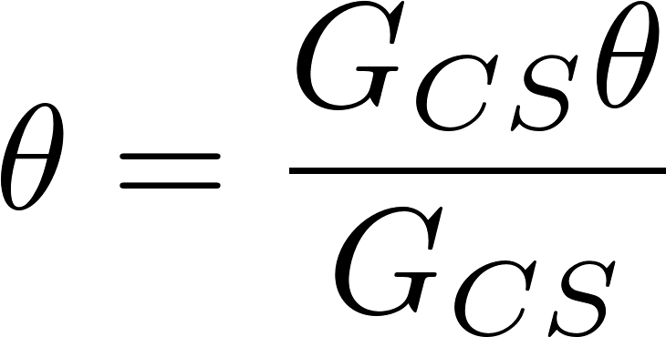
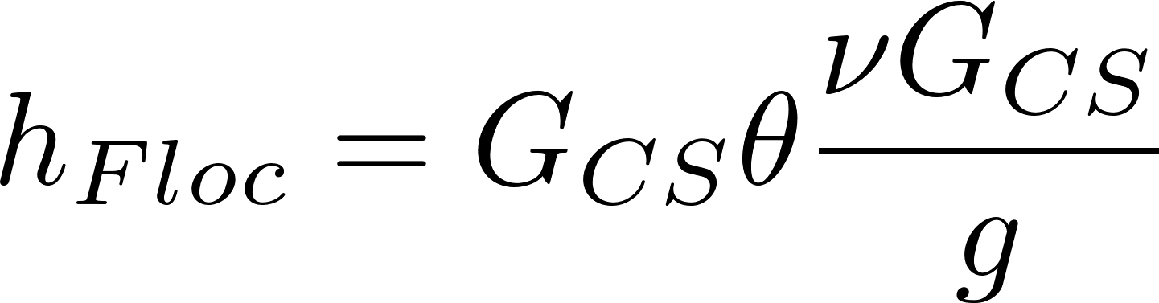
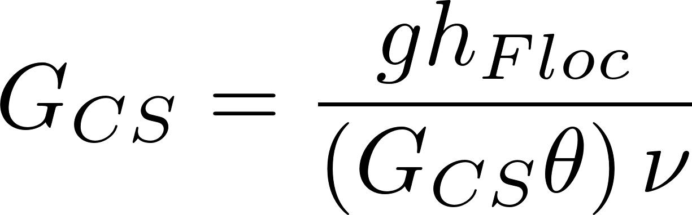
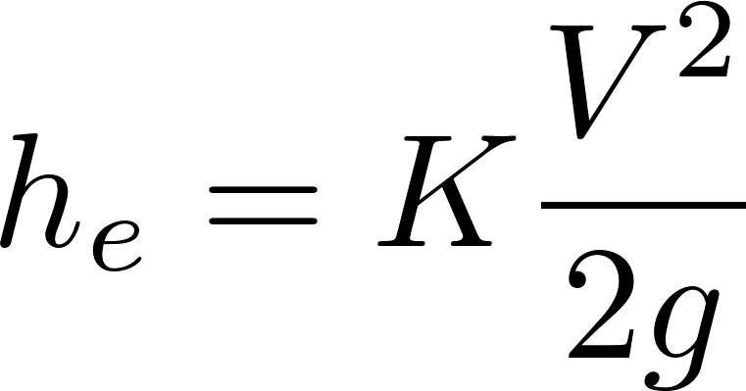
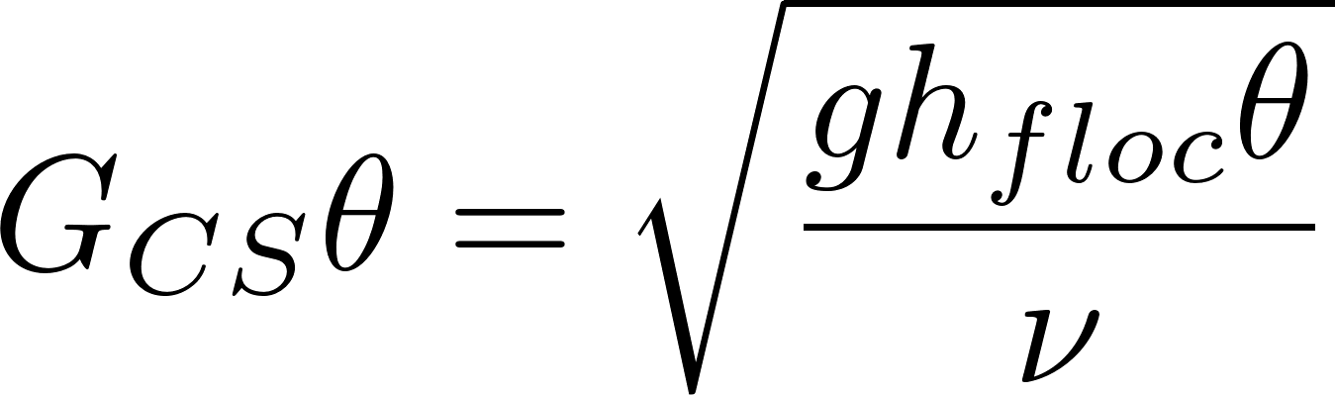
Flocculator design begins with 3 parameters
Sets maximum floc size possible
Sets final concentration of un-flocculated particles
Start with (G_{CS,} G_{CS}θ) and coldest operating temperature
Calculate residence time, θ
Calculate head loss through the flocculator h_{Floc}
G_{CS}(and hence G_{CS}θ) increase in warmer temperatures due to decrease in viscosity
Expansion head loss is independent of temperature
The energy we are putting into the flocculation process is independent of temperature
the fluid deforms less when it is cold
Notes:
We are trying to minimize cost. Setting head loss sets building height and sets flocculator volume. The best design might be minimizing the cost from those two effects.

Slide 26
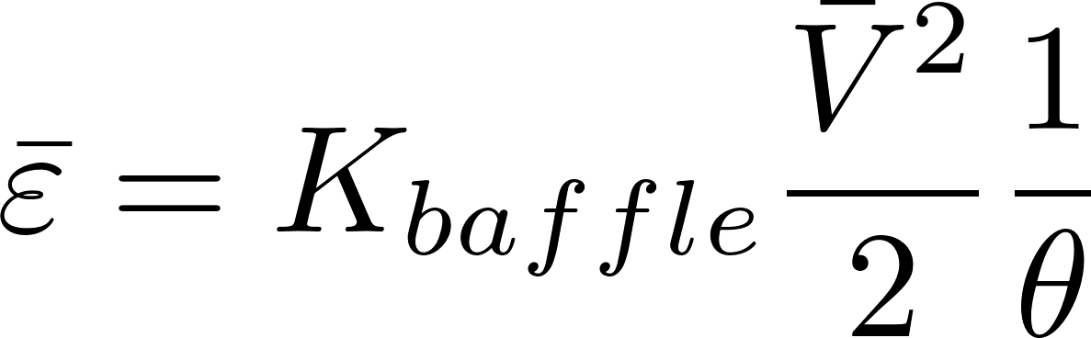
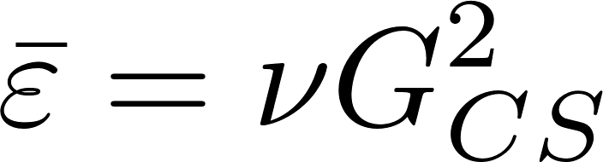
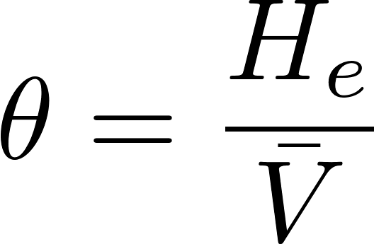
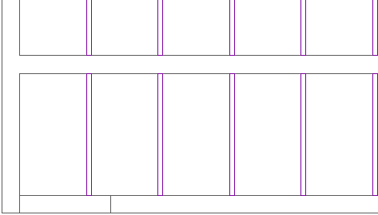
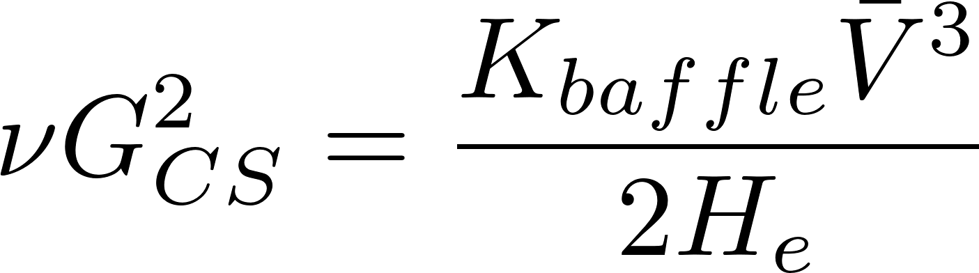
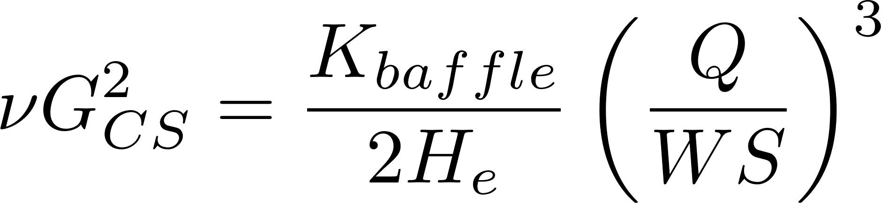
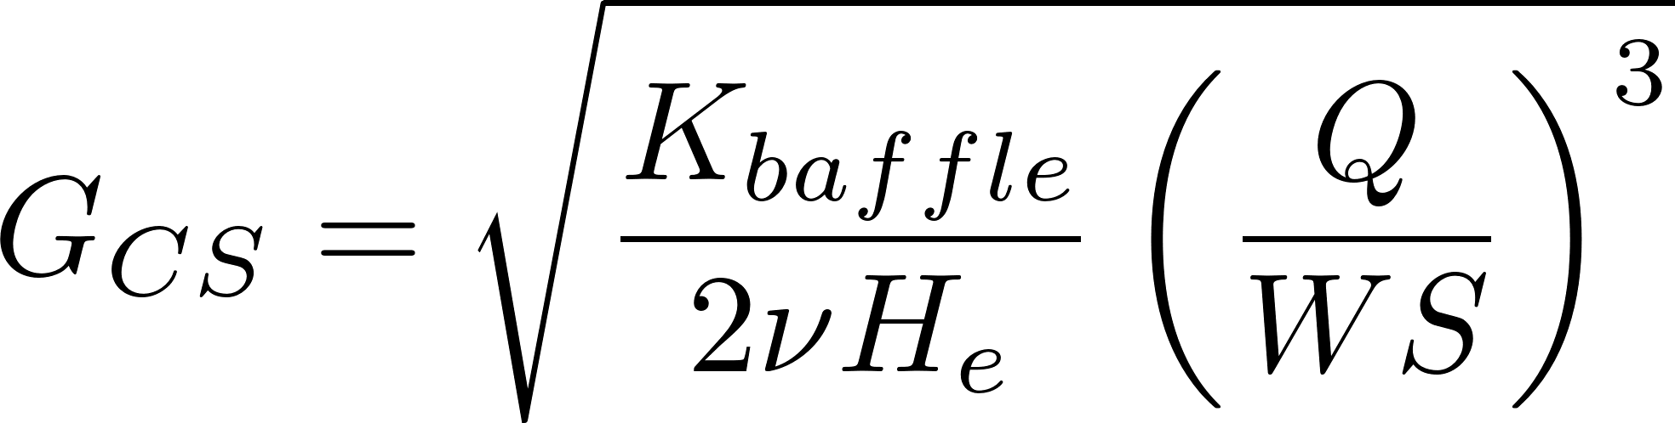
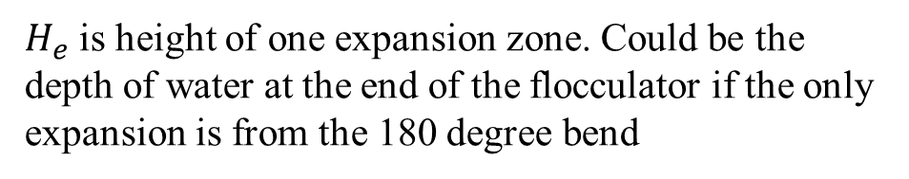
Design the reactor geometry to get the target velocity gradient
Kinetic energy dissipated per residence time
Continuity
S
Rectangular geometry
W
A
$H_{e}$ is height of one expansion zone. Could be the depth of water at the end of the flocculator if the only expansion is from the 180 degree bend
This is our general equation relating velocity gradient to reactor geometry
Notes:
What are the 3 related parameters that set how much energy the flocculator uses?
Gt
Which parameter sets the spacing between baffles? (G, EDR, hl)
Which parameter sets the flocculator volume? t

Slide 27
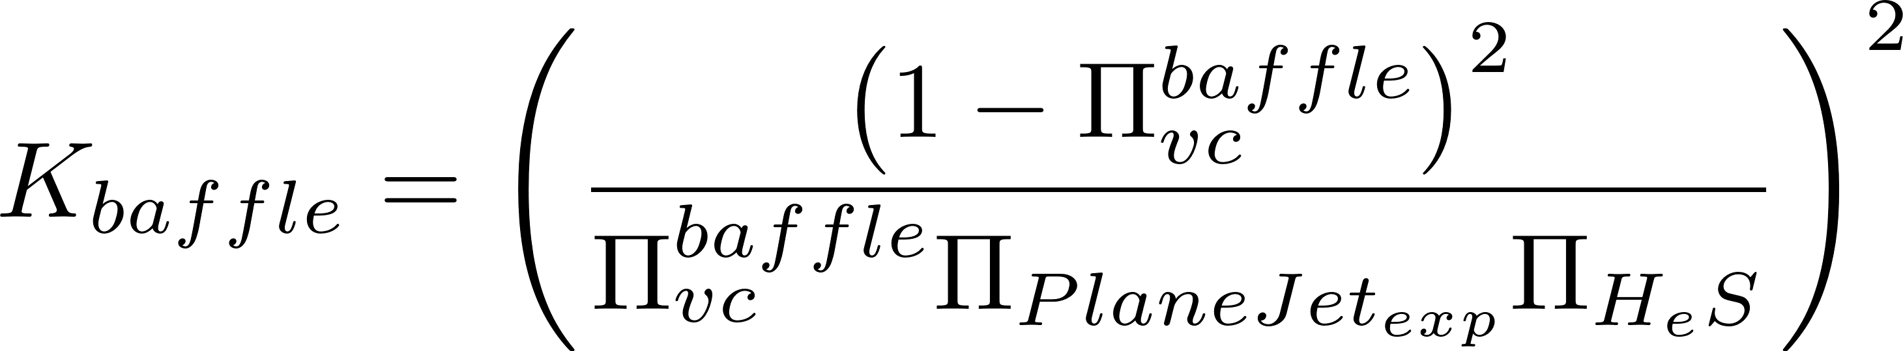
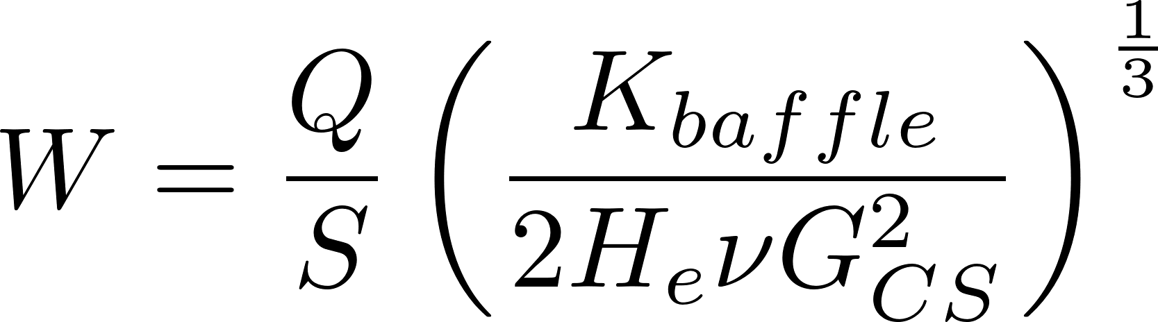
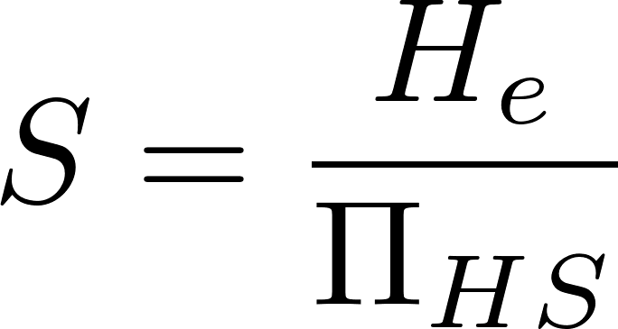
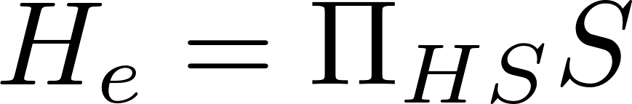


Solve for channel width to set constraints on viable solutions
This is the minimum channel width if we set $Π_{HS}$ = 3 and set the expansion height to equal water depth
Elevation view
As the channel gets narrower the spacing between baffles gets larger.
Channels narrower than this would have barely any or negative baffle overlap!
Notes:
What happens if I make the channel narrower and narrower? What fails?
Find the range of W
Set W
Find the range of He
Set He
Find S

Slide 28







Design Algorithm: Start with G_{CS} and G_{CS}θ
Velocity gradient and flocculator volume given velocity gradient and collision potential
Minimum channel width required to achieve ${H_{e}}/S$>3 (or larger value) and required for constructability
Number of channels is total width divided by the minimum channel width (floor – round up)
Channel width (total width / number of channels)
Maximum distance between expansions
Minimum number of expansions per baffle space
Actual distance between expansions
Baffle spacing
Calculate the obstacle width to obtain the same jet expansion conditions as produced by the 180 degree bend
Where K is from
Notes:
Can you find a place in this algorithm where we have to limit our solution to integers?

Slide 29



Vertical – Horizontal Flocculator for approximately 0.5 – 20 L/s
6 L/s, 23.5 cm head loss
1.8 m
2.65 m

Slide 30



Horizontal – Vertical Flocculator for approximately 20 – 200 L/s
60 L/s
1 m wide channels
25 cm head loss
2.46 m
7.5 m

Slide 31

Horizontal – Horizontal Flocculator for highest flows
m
38 m
6 m
Q = 500 L/s
G = 50 1/s
HL = 0.289 m

Slide 32
Flocculator Geometry: Each of these flocculators has approximately the same depth
Horizontal – Vertical
Vertical – Horizontal
Horizontal – Horizontal

Slide 33
Downstream Water Leve + Head loss gives Upstream Water Level
Downstream water level set by sed tank
Upstream depth set by head loss through the flocculator
We design based on the depth set by the sed tank (ignore the effect of head loss that increases the water depth and retention time)
We get a slightly conservative design (more collision potential than specified)

Slide 34
Flocculator elevations (as if it were one long channel)
Freeboard
Flocculator head loss
Water depth of sed tank inlet
S
We ignore triangle of fluid caused by head loss when calculating residence time
0.4S
H_{Floc}
S
S

Slide 35
An interesting design No this wasn’t AguaClara…
Notes:
How could you fix this?

Slide 36

CEPIS Horizontal Flow Flocculator
Notes:
Horizontal flow results in shallower flocculators for low flow rate plants. Thus vertical flocculators take up less area and thus vertical flocculators are less expensive. Also head loss has less of an impact on flow area in vertical flocculator.

Slide 37
Expansions in Parallel
In baffled flocculators how many flow expansions are there IN PARALLEL?
Design thinking! Best number of parallel flow expansions might be minimum, or maximum, or some intermediate optimum
Invent a flocculator with hundreds of parallel flow expansions
What insight do you have about the distance between flow expansions in series (think about jet expansion or H/S ratios!)
0.6S
0.4S
Notes:
https://docs.google.com/presentation/d/1x5WLhr828aU3fs_sVJR-DtabLioLARgj1UcqUl7FBVA/edit#slide=id.p
Plates with orifices
Or flow through wire mesh

Slide 38

Why is the AguaClara design so different from traditional designs?
Why lower G_{CS}θ?
Uniform velocity gradient, close to plug flow, and floc filter
Why not tapered G_{CS}? (well, not yet, but maybe soon)
Big flocs aren’t our goal and tapering is inefficient energy use
Why much higher G_{CS}?
Our velocity gradient is more uniform and that allows us to use a higher G_{CS,} but we will likely be reducing G_{CS} for cold water and dissolved organics in the future
Why do we use G_{CS} rather than ?
It isn’t an average. It is an approximation that assumes uniform G.
Notes:
Lower Gt because 1) more uniform
No basis for why tapered would be better. In absence of data showing improved performance when coupled with a floc blanket we simplify the design and improve energy efficiency by using constant G

Slide 39


Conclusions
AguaClara Hydraulic flocculators have more uniform velocity gradients than mechanical flocculators
Hydraulic flocculators require a careful design to achieve the target velocity gradient
The flocculator geometry changes dramatically as the flow rate changes

